Slide 1

HOSPITAL MANAGEMENT SYSTEM
TECHMEDICOS

Slide 2
TEAM MEMBERS
FRONTEND
Shivraj
Pavithra
Tanmay
Varsha
BACKEND
Kevin Andrew
Vishnu Vardhan Rao
Ashutosh
Sunayana

Slide 3
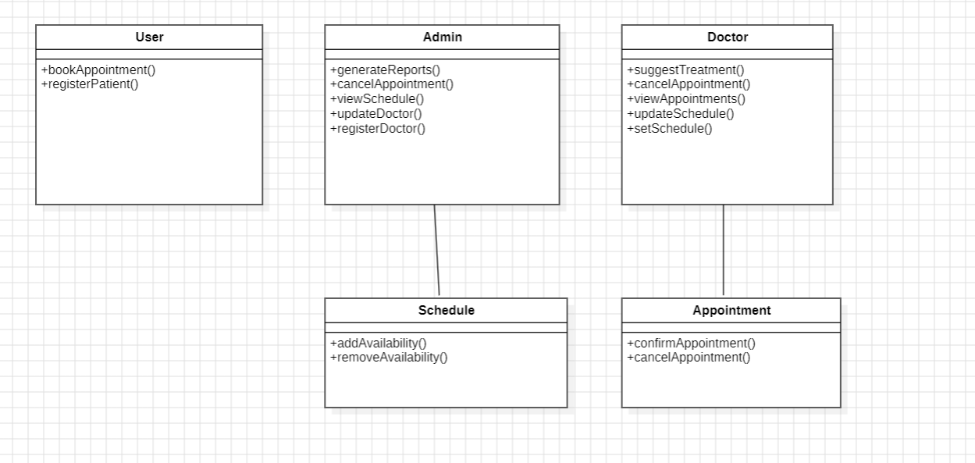
CLASS DIAGRAM ON OPERATIONS

Slide 4
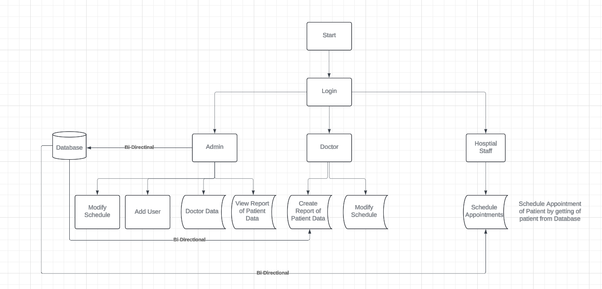
DATAFLOW DIAGRAM

Slide 5
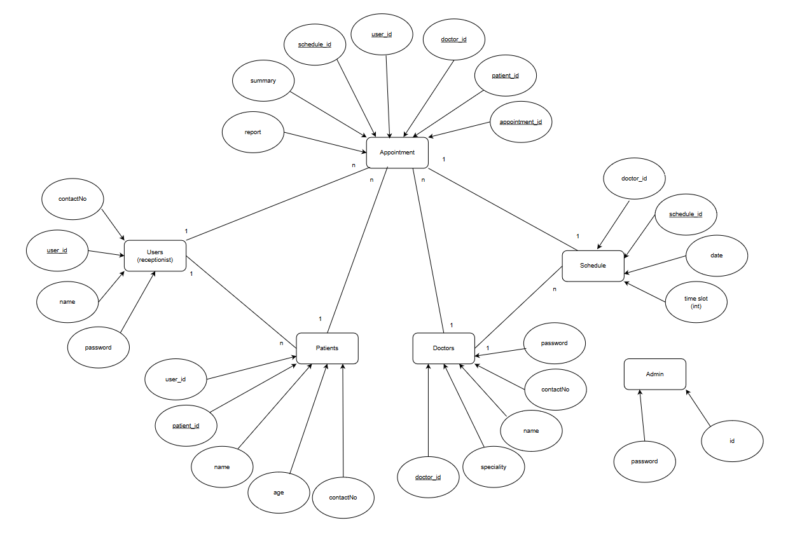
ER DIAGRAM

Slide 6
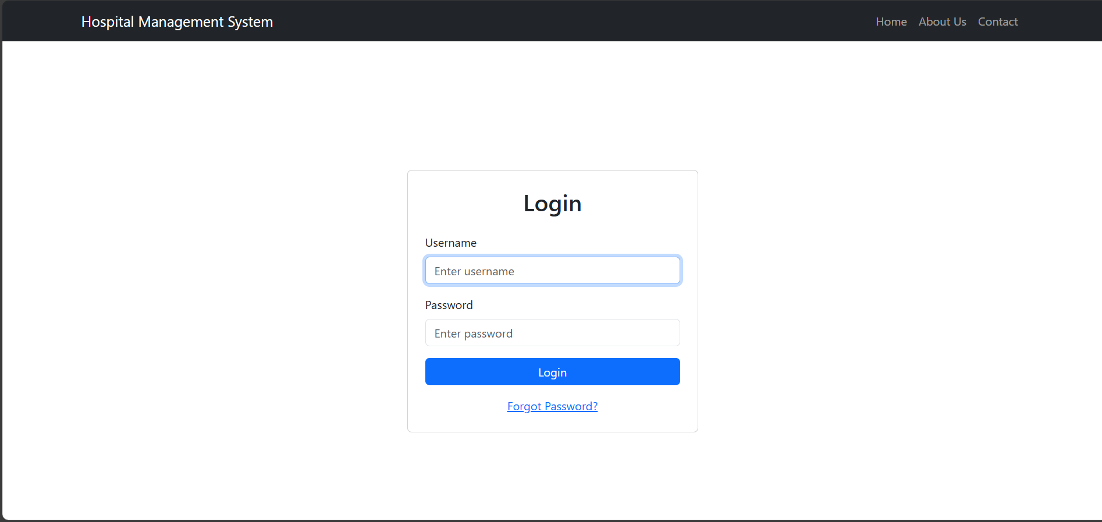
LOGIN PAGE

Slide 7
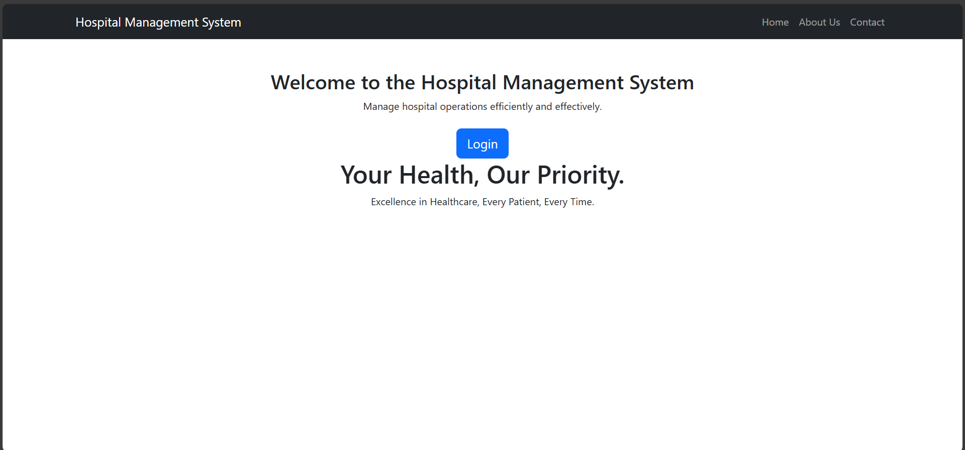
HOME PAGE

Slide 8
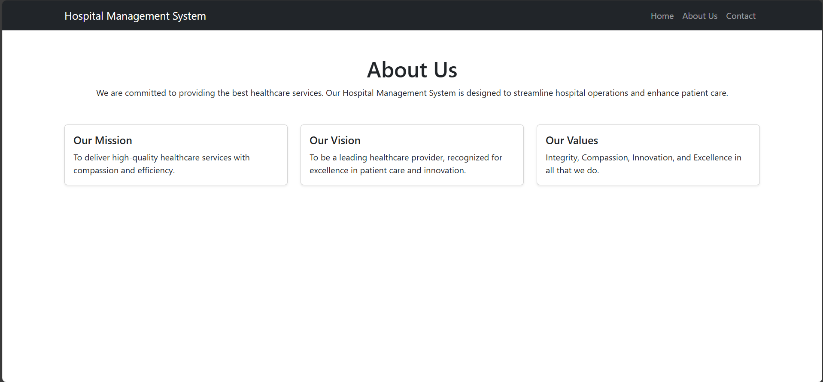
ABOUT US PAGE

Slide 9
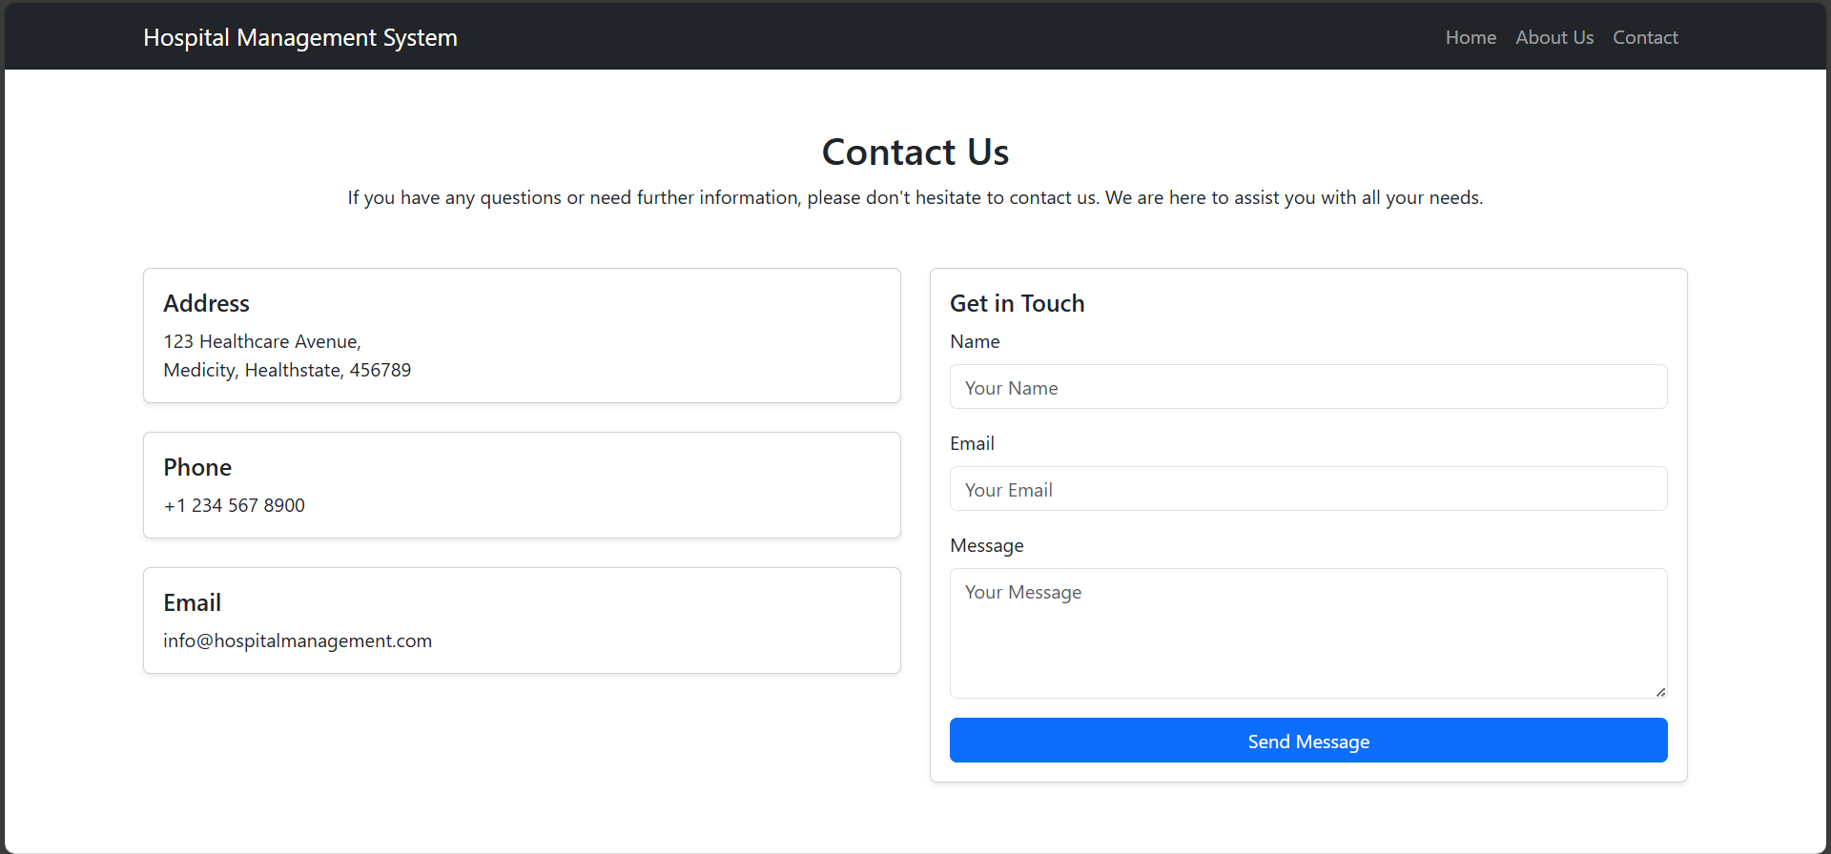
CONTACT PAGE

Slide 10
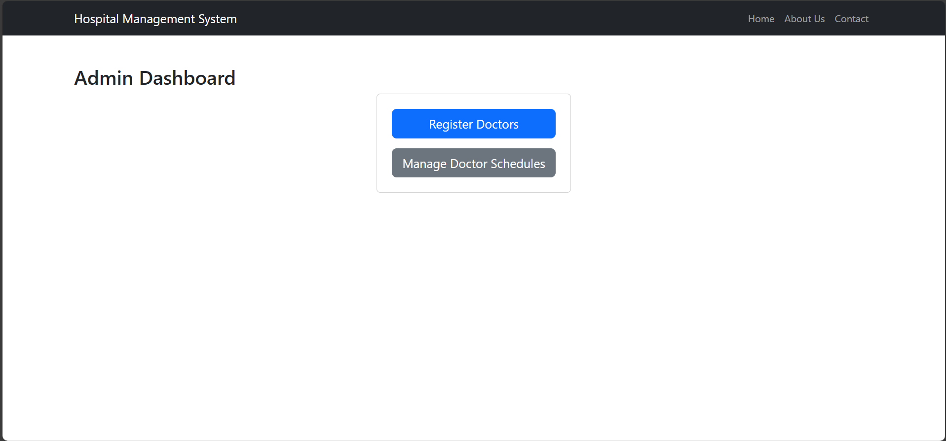
ADMIN DASHBOARD

Slide 11
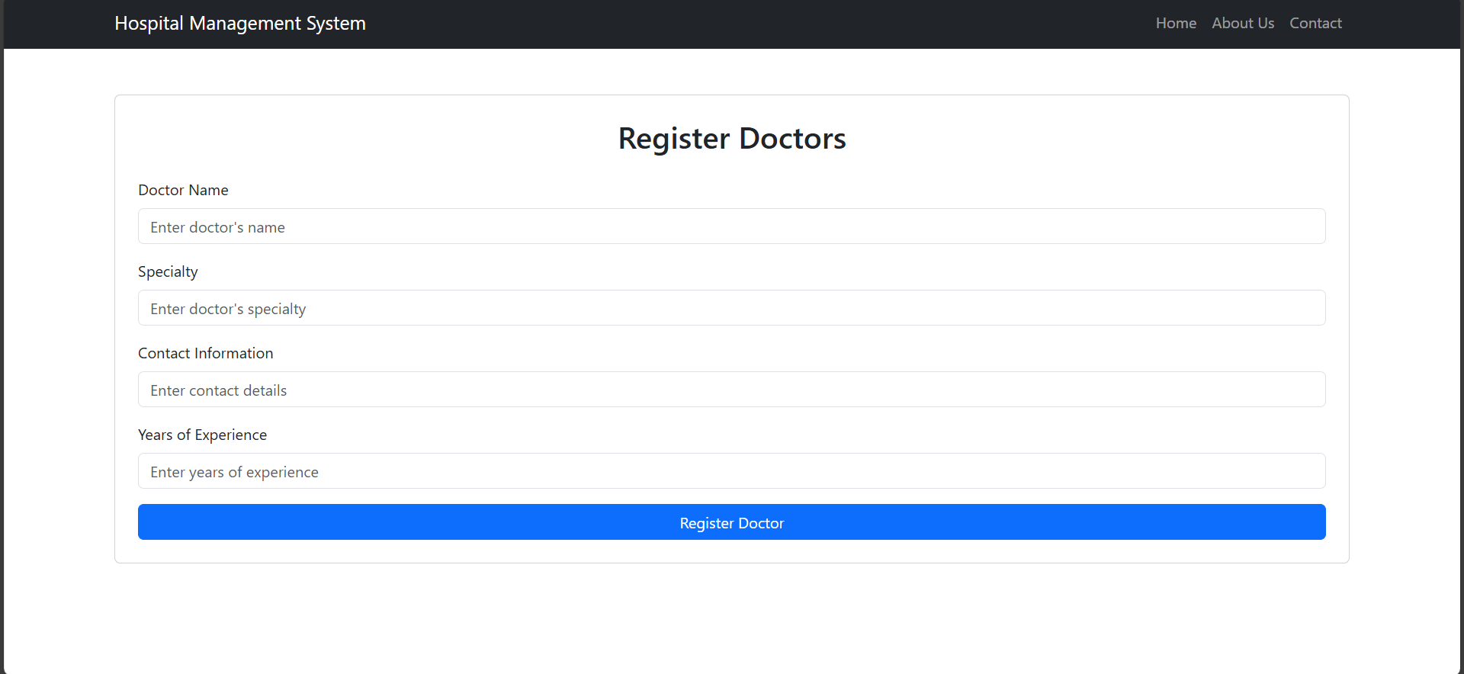
REGISTER DOCTORS

Slide 12
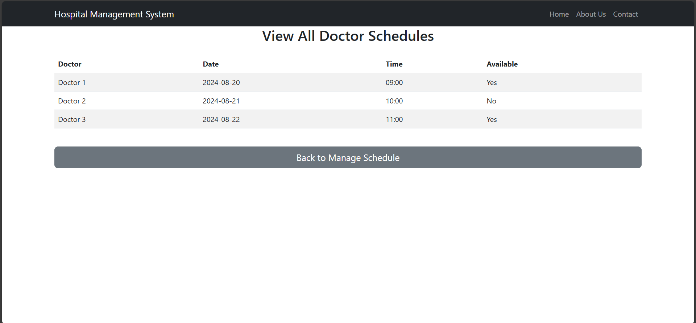
VIEW ALL DOCTOR SCHEDULES

Slide 13
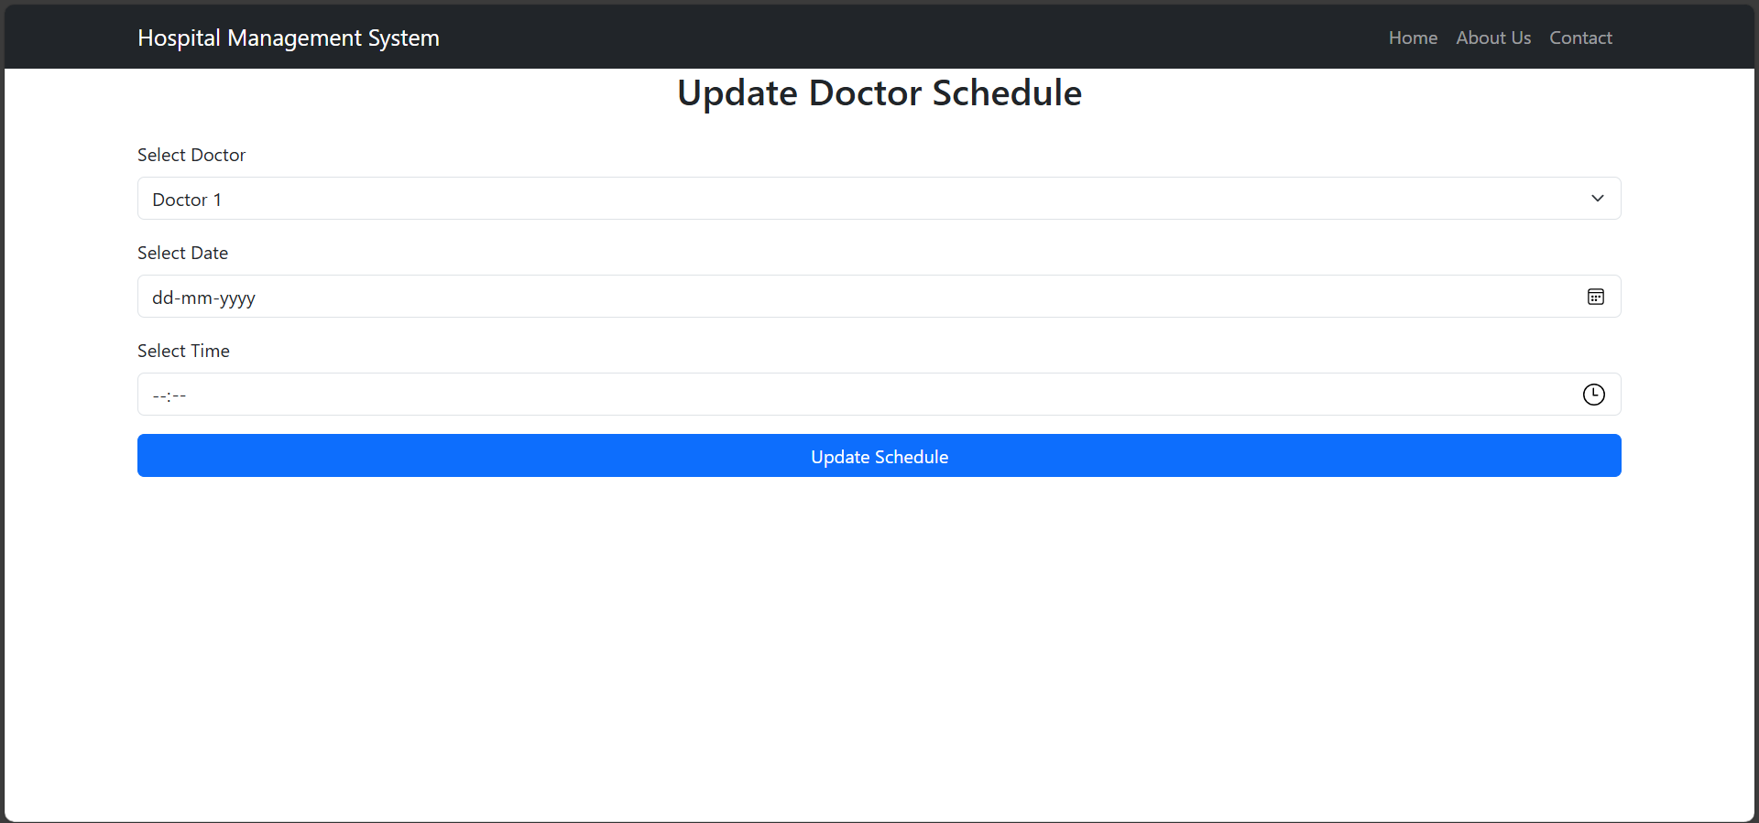
UPDATE DOCTOR SCHEDULE

Slide 14
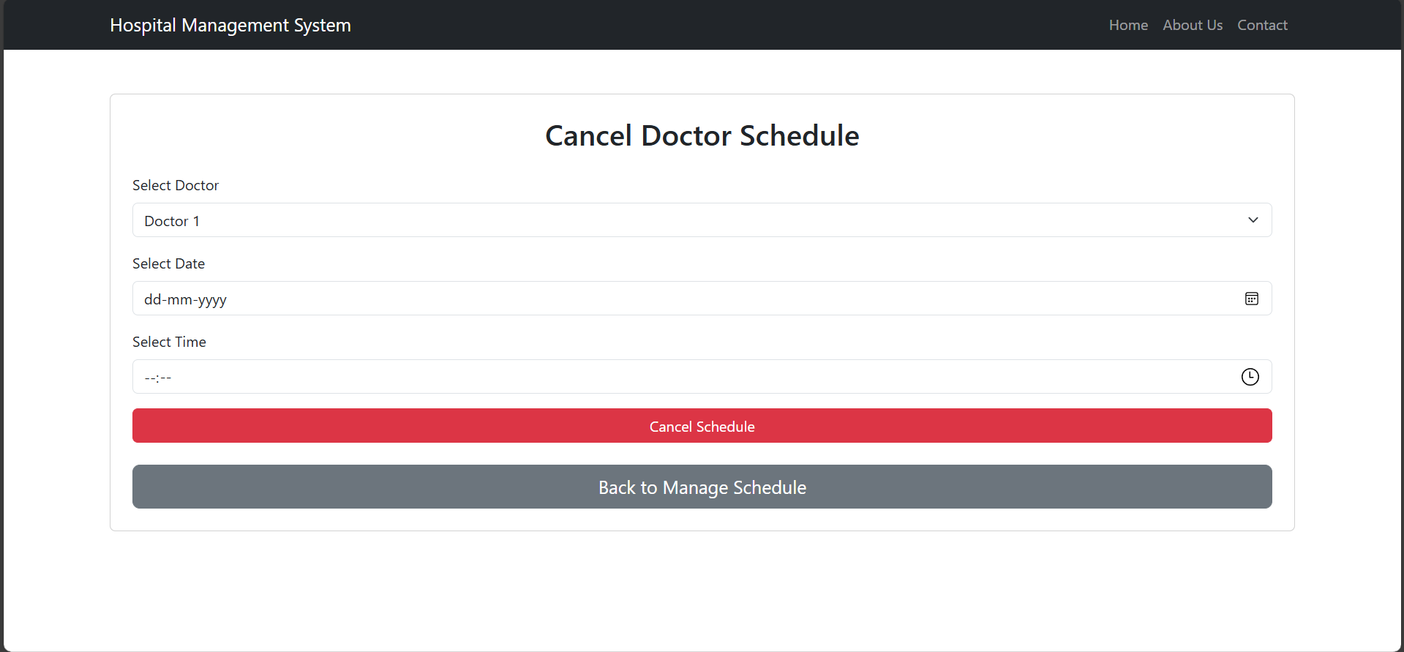
CANCEL DOCTOR SCHEDULE

Slide 15
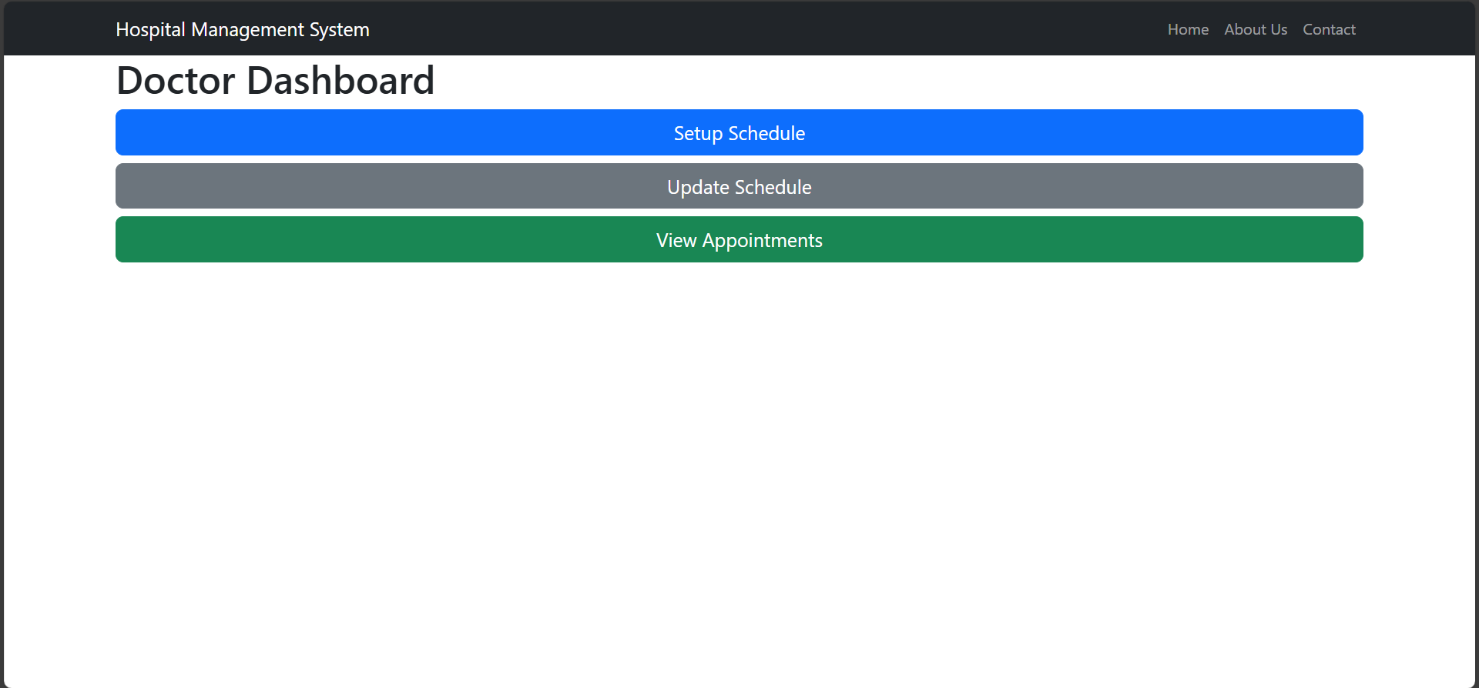
DOCTOR DASHBOARD

Slide 16
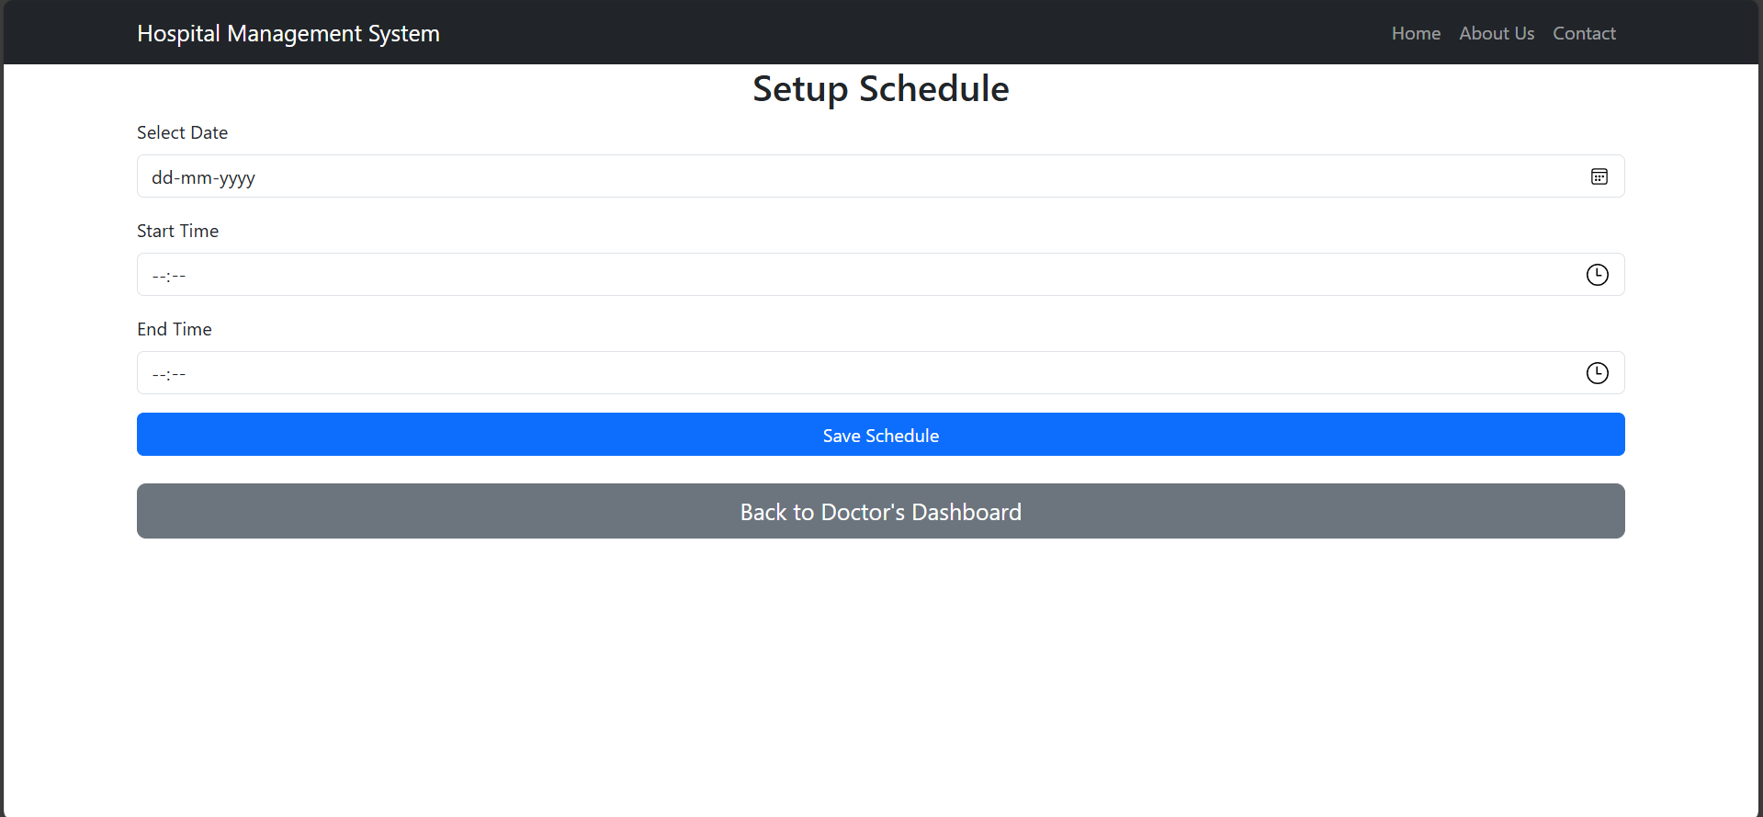
DOCTOR SETUP SCHEDULE

Slide 17
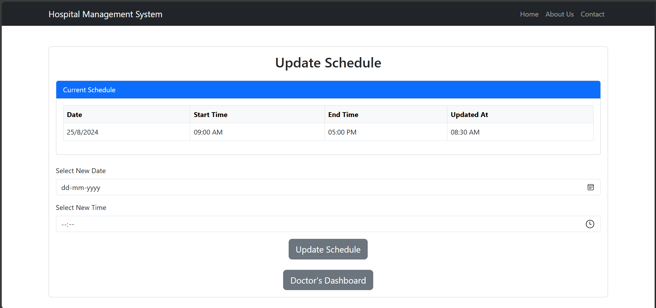
DOCTOR UPDATE SCHEDULE

Slide 18
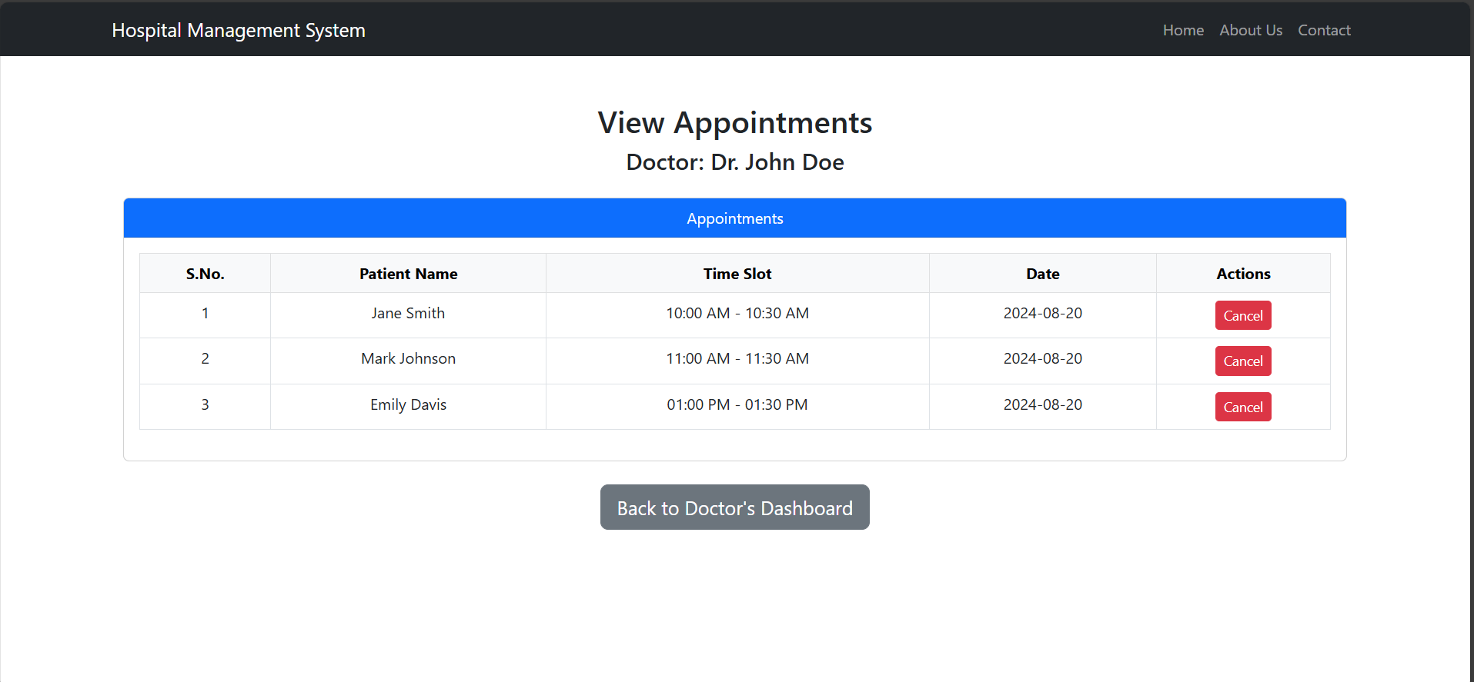
VIEW APPOINTMENTS

Slide 19
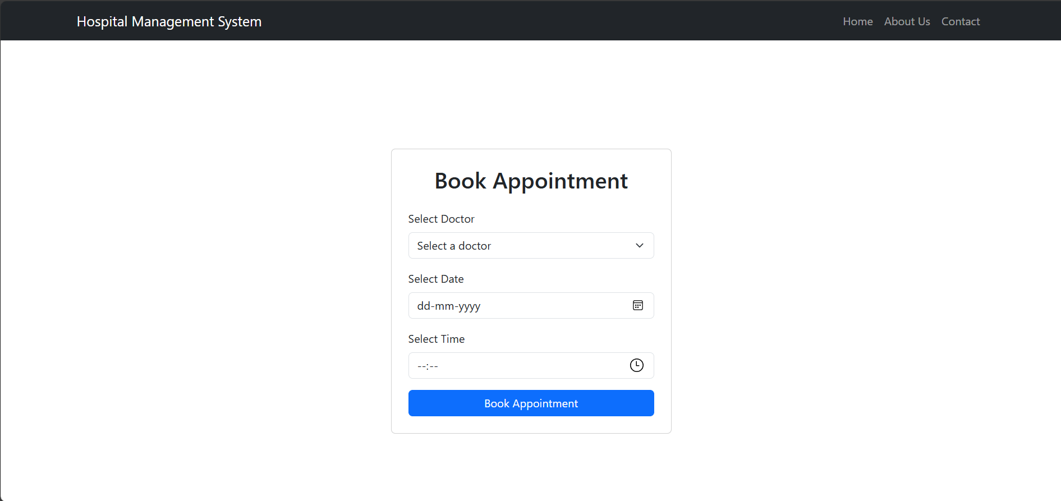
BOOK APPOINTMENT

Slide 20
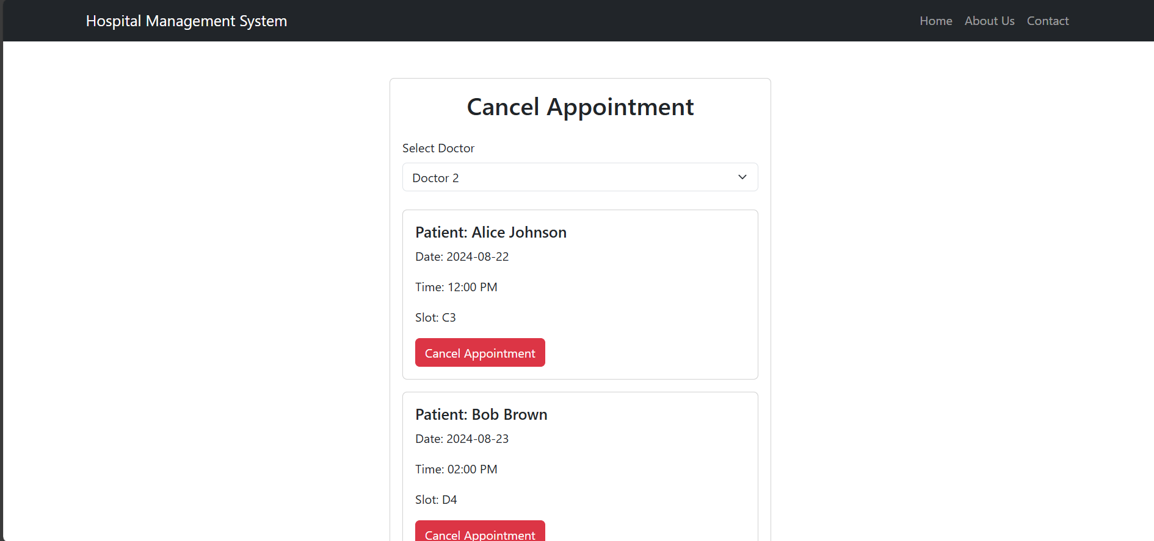
CANCEL APPOINTMENT

Slide 21
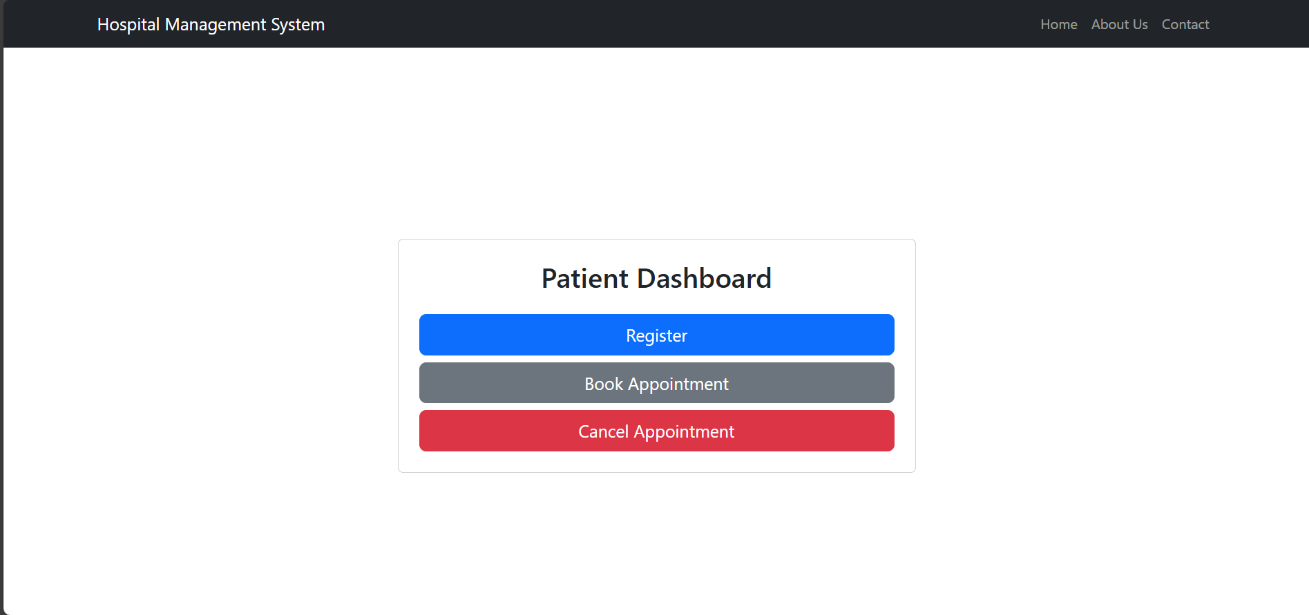
PATIENT DASHBOARD

Slide 22
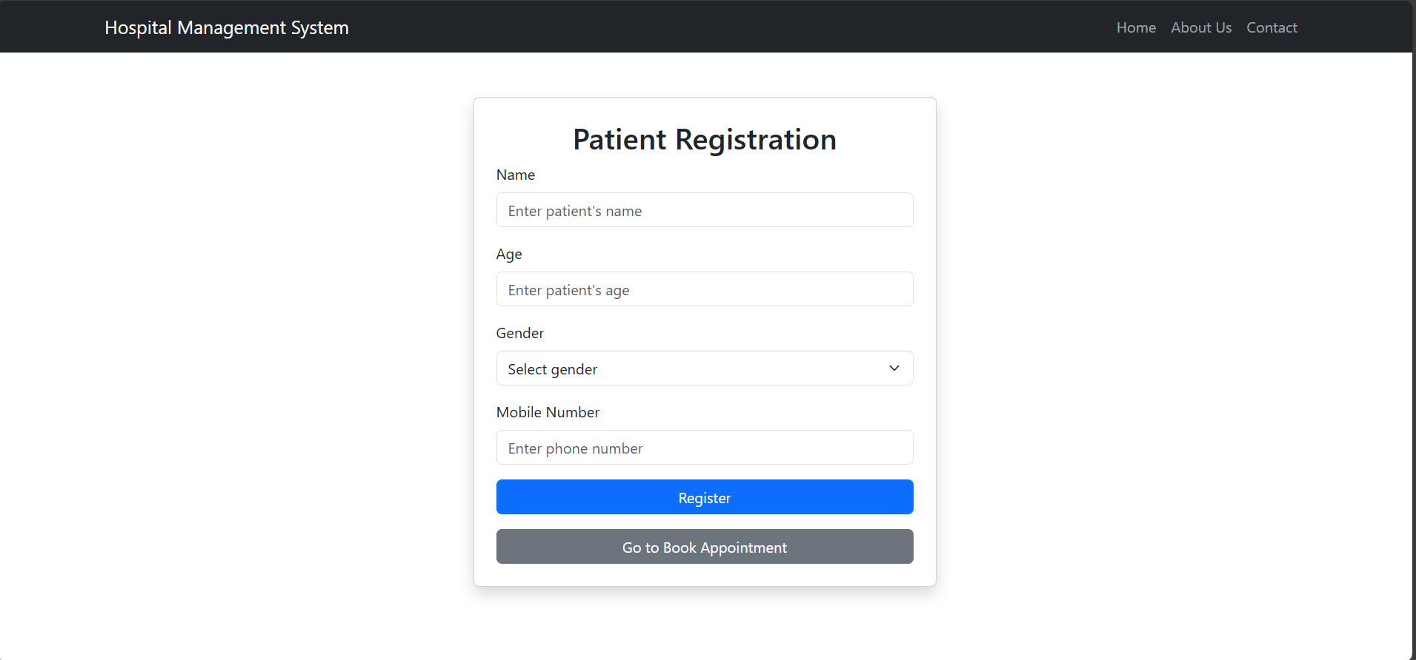
PATIENT REGISTRATION

Slide 23
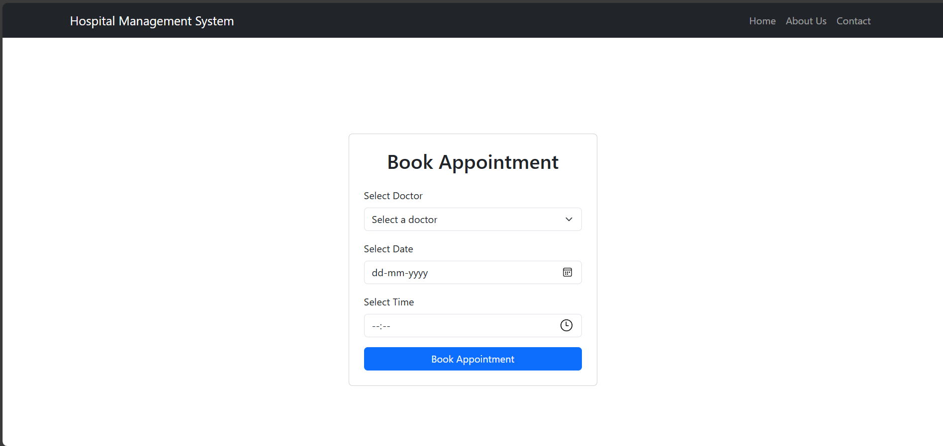
PATIENT BOOK APPOINTMENT

Slide 24
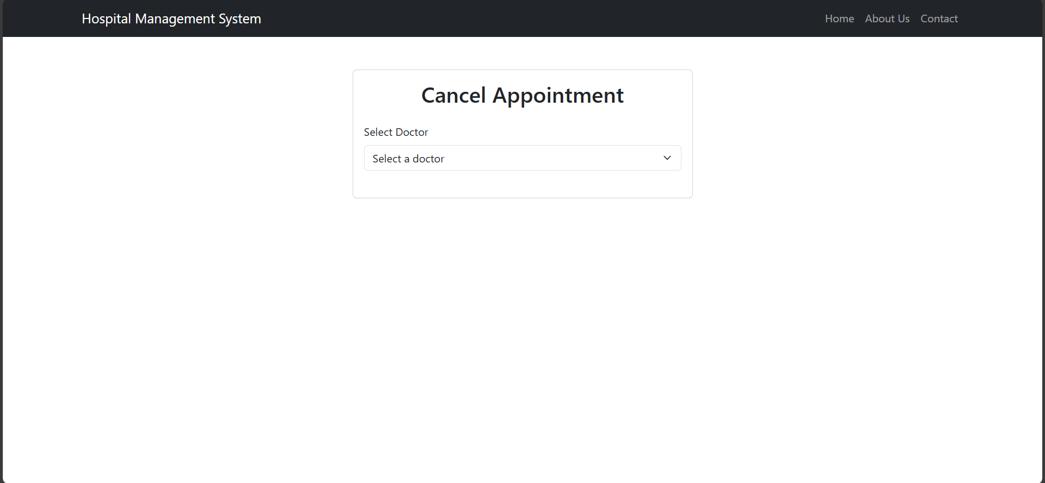
CANCEL APPOINTMENT

Slide 25

THANK YOU

